Slide 1
Disgusting
Things Found in Food
http://home.bt.com/news/odd-news/maggots-mice-and-deadly-spiders-21-of-the-most-disgusting-things-found-in-food-11363954811297

Slide 2
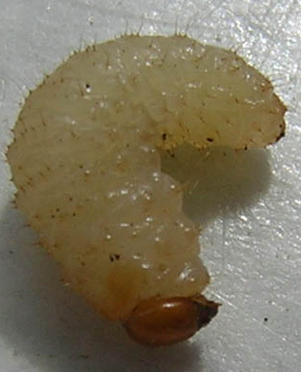
a 12-year-old girl found eight maggots in a sealed bag of Morrisons’ own-brand boil-in-the-bag rice.

Slide 3
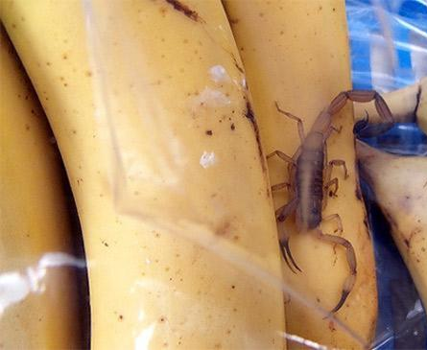
a live scorpion in a sealed packet of Fyffes bananas

Slide 4
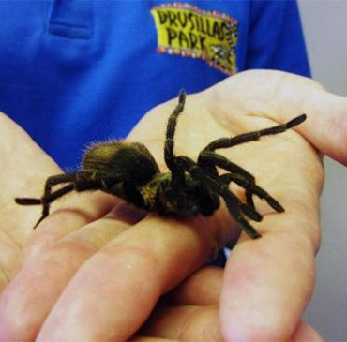
A stowaway South American tarantula discovered in a shipment of bananas

Slide 5
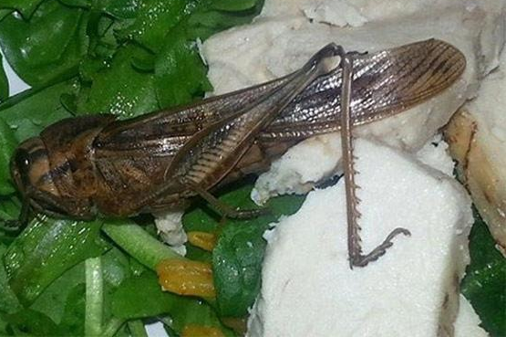
Locust in a bag of Waitrose salad

Slide 6
A couple of weeks before, retired headmaster Paul Poli said he was put off fish for life after spotting a tongue-eating parasite on a sea bass.

Slide 7
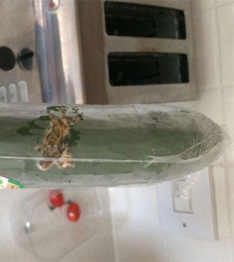
A squashed gecko was found packed up with in a cucumber

Slide 8
Frog found alive in a bag of Waitrose salad

Slide 9
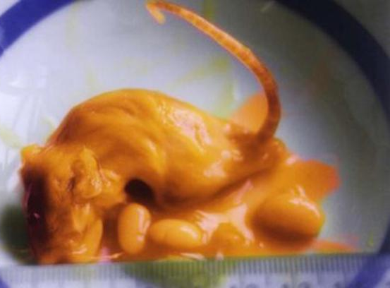
Sainsbury’s was fined after this dead mouse was found in a tin of own-branded baked beans.

Slide 10
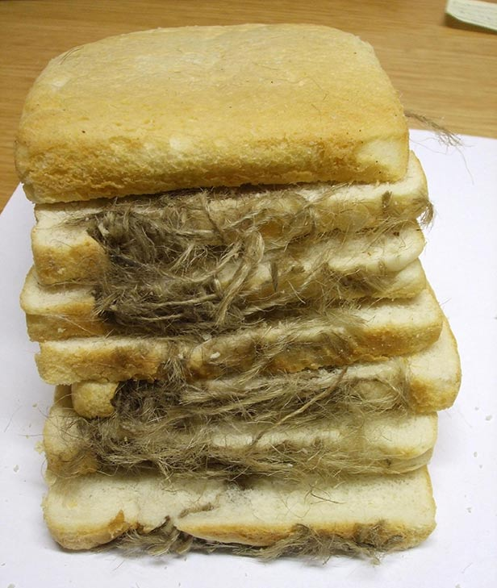
A loaf of bread with part of an oven glove baked into it

Slide 11
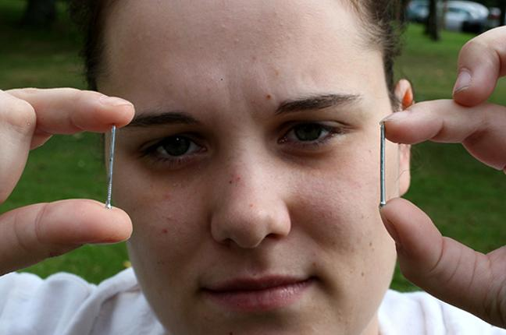
A bride-to-be had to go to hospital after swallowing a one-inch nail in her 79p Tesco Value macaroni cheese.
The product was recalled from the shelves after she found another nail buried within the meal.

Slide 12
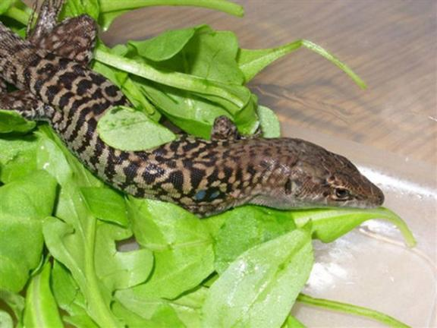
A lizard named Rocky found a new home in Scotland after surviving a journey from the Middle East to Scotland in a bag of salad

Slide 13
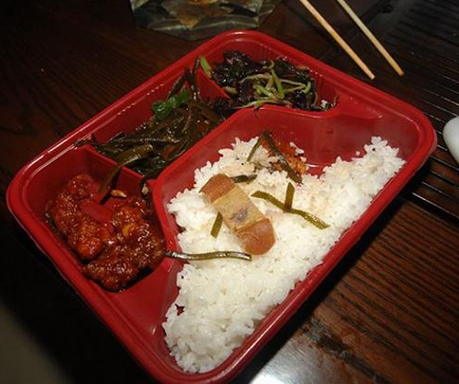
A Chinese woman was horrified to discover this used plaster in her food after she ordered a takeaway

Slide 14
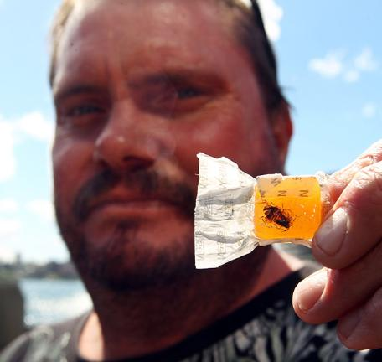
A packet of butter Menthols came with an extra crunch
Found a cockroach inside the wrapper

Slide 15
STRAND 1 Students will consistently demonstrate kitchen safety procedures and sanitation techniques. Standard 1: I CAN apply established safety rules and guidelines to maintain a safe working environment. Standard 2 I CAN Identify proper first-aid procedures for cuts, burns and electrical shock. Standard 3 I CAN Identify health and hygiene requirements for food handling. Standard 4 I CAN Identify and apply sanitation rules and guidelines.

Slide 16
KITCHEN SAFETY with
®

Slide 17
Please look a the following picture for 3 minutes and identify 6 UNSAFE aspects of the picture you see in your packet.

Slide 18
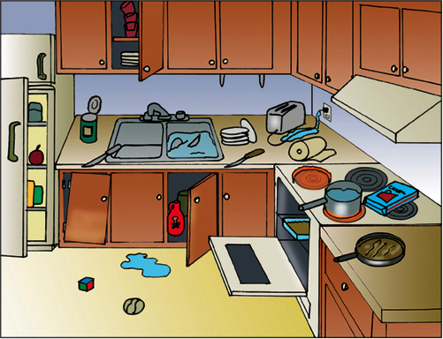
UNSAFE KITCHEN…where??

Slide 19
Some reasons why this kitchen is unsafe:
Open fridge door (someone could run into it)
Open cupboards above (things fall out, bump your head on the corner)
Broken cabinets below
Open can with sharp lid
Knife sticking out of dish water
Open cabinets below (chemicals at reach of children)
Spills
Knives facing out
Toys
Open oven
Dishes everywhere
Unstable stacked dishes
Water with plugged in toaster
Pot handle facing out
Heated Ranges
Box on/near hot ranges
Pan handle out
No oven mitts
Paper towels near hot range (unused)
No person
No soap
Notes:
Okay, there are a lot of things wrong with this kitchen. Maybe yours doesn’t have ALL of these. But what are some common problems we can think of in our kitchens? What things obviously don’t mix? (anything flammable by hot stove ranges, water + electricity, chemicals at child’s reach, open cupboards above and below, etc…

Slide 20
3 Major Lab Safety Issues
Notes:
The 3 major accidents in our lab kitchens can be divided into these 3 categories. Tell the story of Elisa’s brother, 2nd degree burns all over his front because of the pan handle sticking out from the stove with hot spaghetti sauce. READ FROM PRINT OUT KITCHEN SAFETY

Slide 21
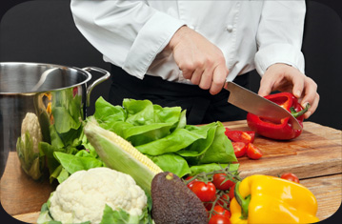
Kitchen Safety
The kitchen can be one of the MOST dangerous places in the home, in the classroom and in the industry.
It is critical that you understand the principles of kitchen safety and sanitation in order to keep yourself and others safe while cooking.

Slide 22
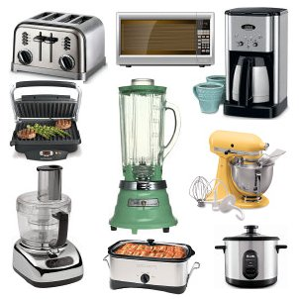
Electrical Appliances
Use dry hands.
Stand on a dry floor.
Keep appliances away from water.
Multiple plugs can overload circuits and increase hazards

Slide 23
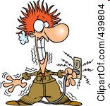
Electrical Appliances
In case of electrocution, turn off the
1st Step: Turn off the MAIN POWER SOURCE
2nd Step: Check surroundings before touching the person or the appliance.

Slide 24
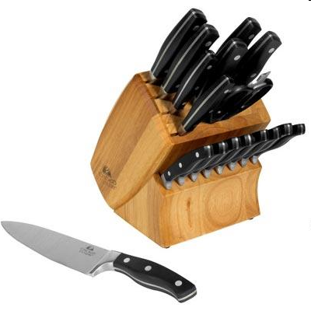
Knife Safety
A dull knife is dangerous and inefficient.
The best knives are SHARP knives because they use less pressure.

Slide 25
Preventing CUTS
Hand placement: the CLAW or the FLAT HAND TOP
Wash knives separately
Put all broken glass in the SHARPS BIN
Remove can lids completely, place in the sharps bin
Notes:
Discuss these procedures. Talk about the first aid.

Slide 26
First Aid for CUTS
If it’s spurting, we get emergency help (arterial cut)
If it’s oozing (as most cuts will), you need to
Wash with soap and water
Apply direct pressure
Clean up and bandage
Any more than that, we can get the nurse

Slide 27
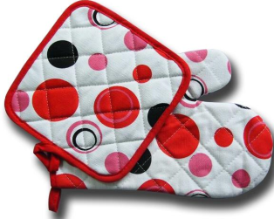
Avoiding Burns
Keep clothing away from direct heat.
KEEP paper/plastic away the stovetop.
Use hot pads/oven mitts for handling hot pans. (Including microwave cooking.)

Slide 28
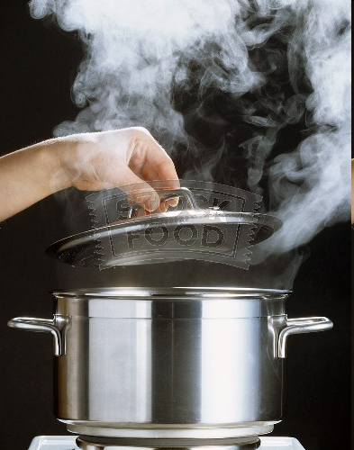
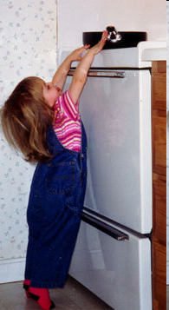
Avoiding Burns
Lift lids on hot foods away from you and your face. Direct the steam away.
Turn pan handles toward the inside or back of the stovetop.

Slide 29
About burns….
TYPES:
1st (like a sunburn)
2nd (usually has blisters)
3rd (severe tissue damage)
SOURCES:
Thermal (heat), Chemical, Electrical
*Did you know? Just 3 seconds of exposure to water at 140 degrees can cause a 3rd degree burn in an adult. At 156 degrees the same burn occurs in one second. That’s still 40 degrees less than boiling water.

Slide 30
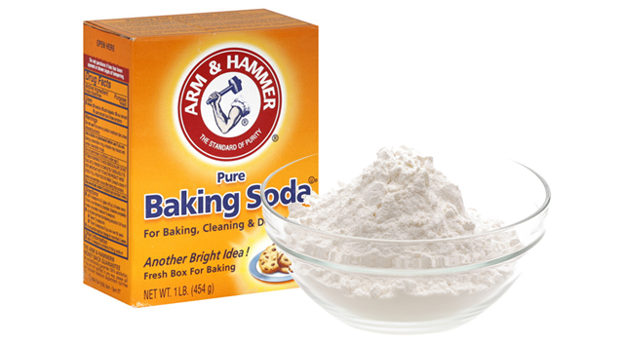
Extinguishing a Grease Fire
Cover with a lid.
Smother with baking soda
Use a fire extinguisher.

Slide 31
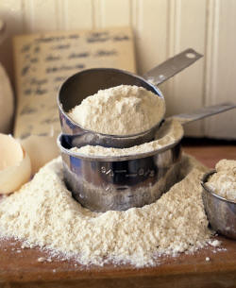
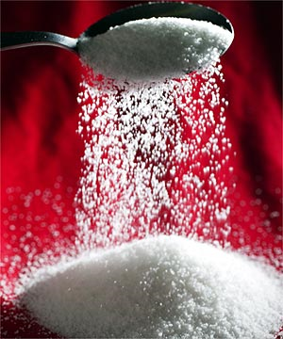
Never Use on a Grease Fire
Water
Sugar
Flour

Slide 32
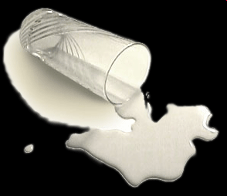
Avoiding Tripping/Falling
Clean up spills as soon as they happen.
Use a step stool to reach things in high places.
Store heavy items on lower shelves.

Slide 33
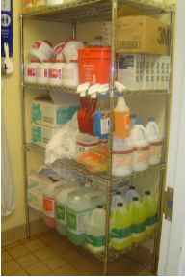
Cleaning Supplies and Chemicals
Store cleaning supplies away from food in designated areas, equipment, utensils, linen and single-use items in a designated area.
Keep cleaning chemicals in their original containers or have them clearly labeled.

Slide 34
Cleaning Supplies and Chemicals
Never mix cleaning supplies.
Combinations like ammonia and bleach will produce toxic deadly fumes.

Slide 35
POTATO EXPERIMENT

Slide 36
SANITATION & HYGIENE with
®

Slide 37
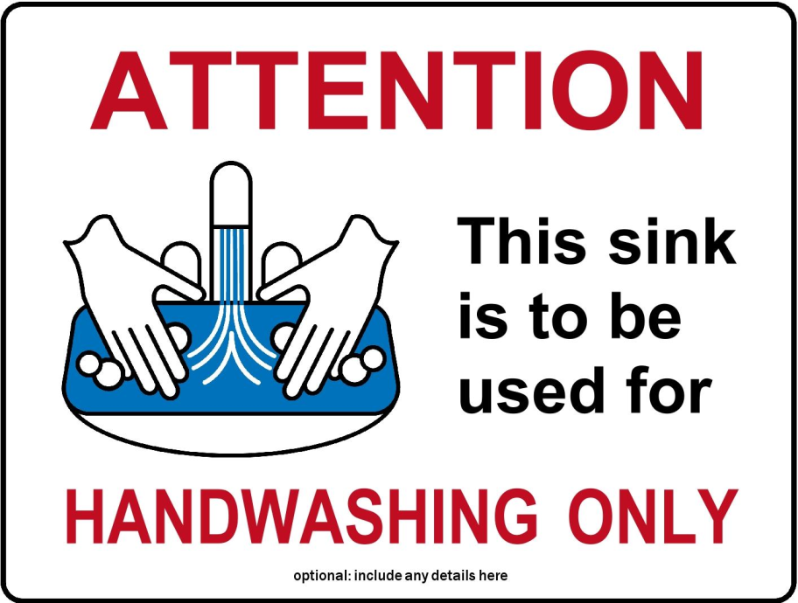
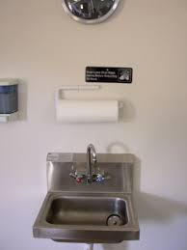
Handwashing Sink
The handwashing sink is to be used for handwashing ONLY.
Never use this sink for other purposes.

Slide 38
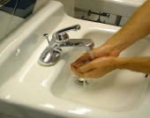
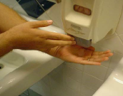
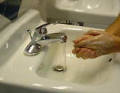
Washing Hands- a 20 second process
Wet hands and arms with warm/hot water.
Apply soap.
Scrub hands and arms vigorously for at least 10-15 seconds.
Rinse hands and arms thoroughly.
Use an antiseptic after washing hands
Wait for antiseptic to dry before touching food or equipment and before putting on gloves.

Slide 39
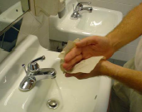
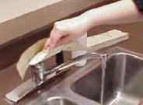
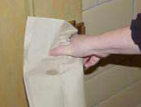
Drying Hands
Dry hands and arms with a paper towel.
Do not use apron or clothing.
Use paper towels to turn off the faucet and open doors.

Slide 40
When to Wash Hands
After using the restroom
After coughing/sneezing
Before & after handling raw meat, poultry or eggs
Before putting on gloves
After touching clothing or aprons
After handling money
After handling garbage or trash
After handling dirty equipment/utensils
Before, during and after food preparation

Slide 41
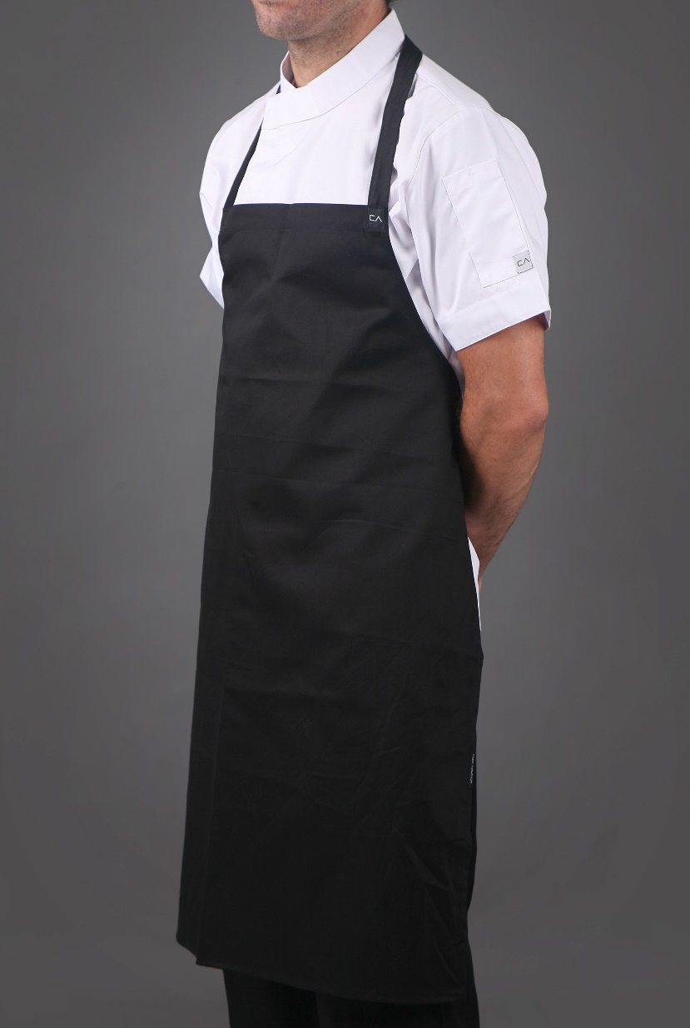
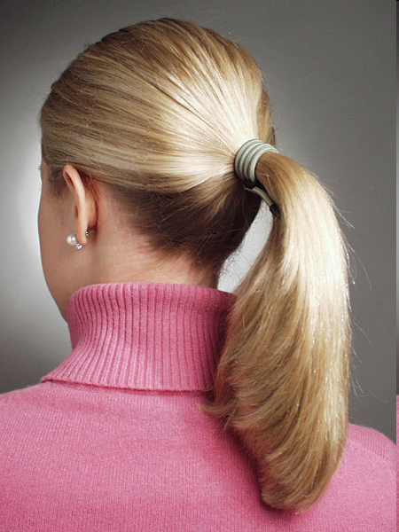
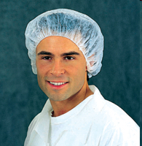
Clothing, Hair and Jewelry
Wear clean clothing and aprons.
Tie back or cover hair.
Remove jewelry from hands and arms including rings, bracelets and watches.
Expect for a plain band

Slide 42
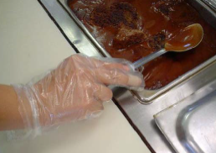
Wearing Gloves
Avoid bare-hand contact with ready to eat foods.
Wear gloves if you have open sores or cuts on hands.
A bandage must cover the wound completely and a glove must be worn over the bandage.
Use the correct size so they fit.
Never rinse, wash or reuse gloves.
Wash hands before putting on gloves and when changing to a new pair.
Change gloves with each new task.

Slide 43
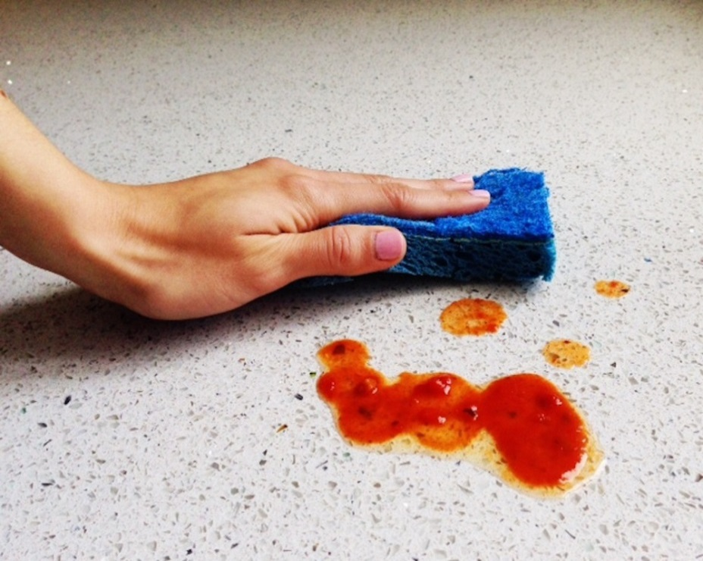
Cleaning and Sanitizing
Disinfect work surfaces to prevent cross-contamination.
Surfaces that are in constant use must be cleaned and sanitized after 4 hours.
If taste testing foods, always use a clean spoon and use it only once.

Slide 44
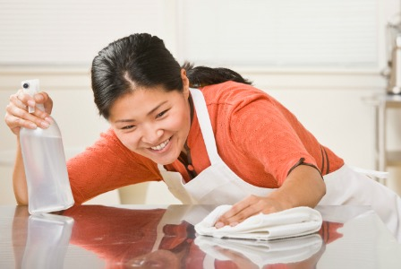
Cleaning and Sanitizing
1. Scrape or remove food from the surface.
2. Wash the surface.
3. Rinse the surface.
4. Sanitize the surface.
5. Allow the surface to air dry.

Slide 45
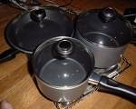
Dish Washing - By Hand
Wash dishes in the following order:
CLEANEST 1st
Rinse and Scrape Food
Glassware
Silverware
Dishware (Plates/Bowls)
Kitchen Tools
Pots and Pans

Slide 46
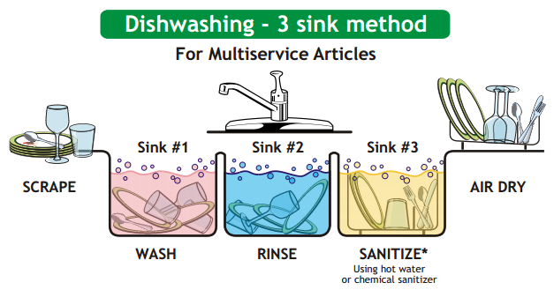
Dish Washing – 3 Sink Method
Scrape, Wash, Rinse, Sanitize and Air Dry

Slide 47
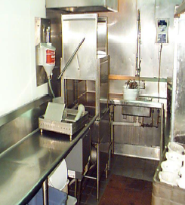
Dish Washing – Dish Machine
Dish machines are used in the industry to quickly clean and sanitize dishes.
Scrape, rinse or soak items before washing.
Never overload the dish racks and use the correct racks.
Frequently check water temperature and pressure.
Change the water when necessary.

Slide 48
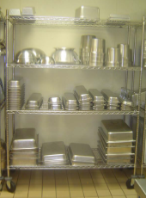
Storing Dishes and Utensils
Store in a clean, dry location.
Store at least 6-inches above the floor.
Store upside down on a clean, sanitized surface.
If storing utensils vertically, store them with handles up.

Slide 49
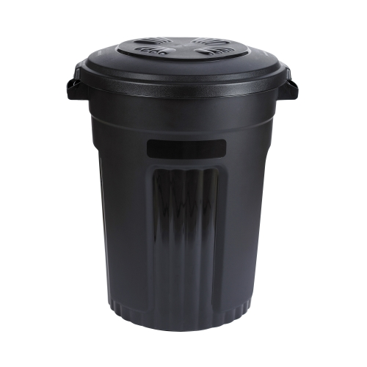
Trash and Garbage
Remove garbage from prep area as quickly as possible.
Do not clean garbage containers need food prep areas.
Use trashcan liners
Clean the inside and outside of garbage containers often.
Close the lids on outdoor containers.

Slide 50
STRAND 1 Students will consistently demonstrate kitchen safety procedures and sanitation techniques. Standard 1: I CAN apply established safety rules and guidelines to maintain a safe working environment. Standard 2 I CAN Identify proper first-aid procedures for cuts, burns and electrical shock. Standard 3 I CAN Identify health and hygiene requirements for food handling. Standard 4 I CAN Identify and apply sanitation rules and guidelines.

Slide 51
Can You Find The Hazards?
ONLY USE IF YOU HAVE EXTRA TIME
Watch the video and find at least 5 safety sanitation violations
https://www.youtube.com/watch?v=KBvU4Bmu5O0

